Slide 1
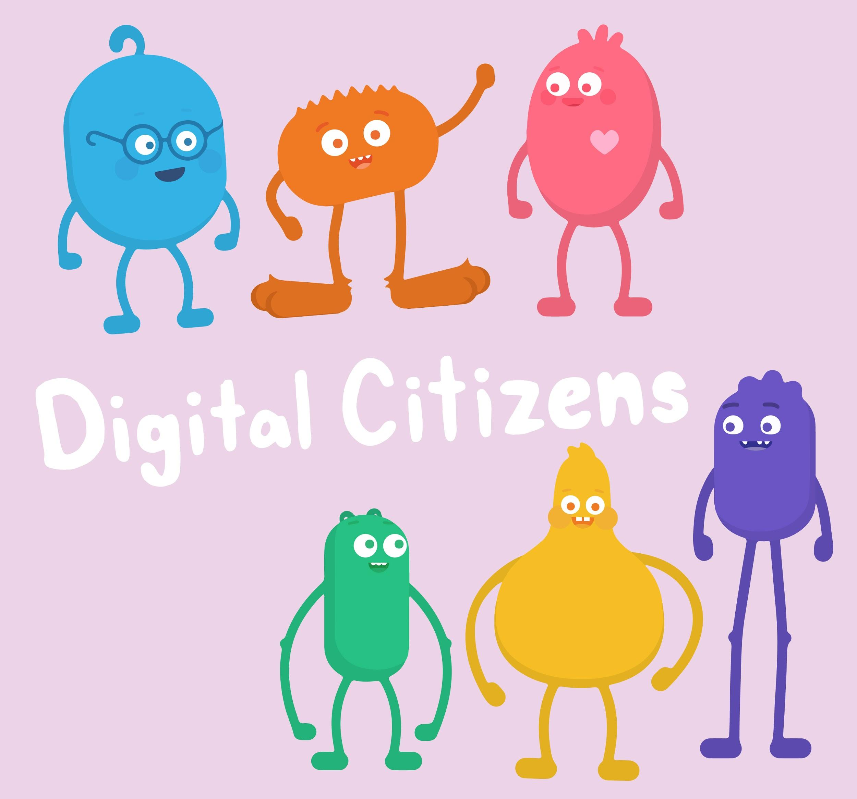

INTRODUCTORY SONG
DIGITAL CITIZENSHIP | GRADE 1
Pause & Think Online

Slide 2
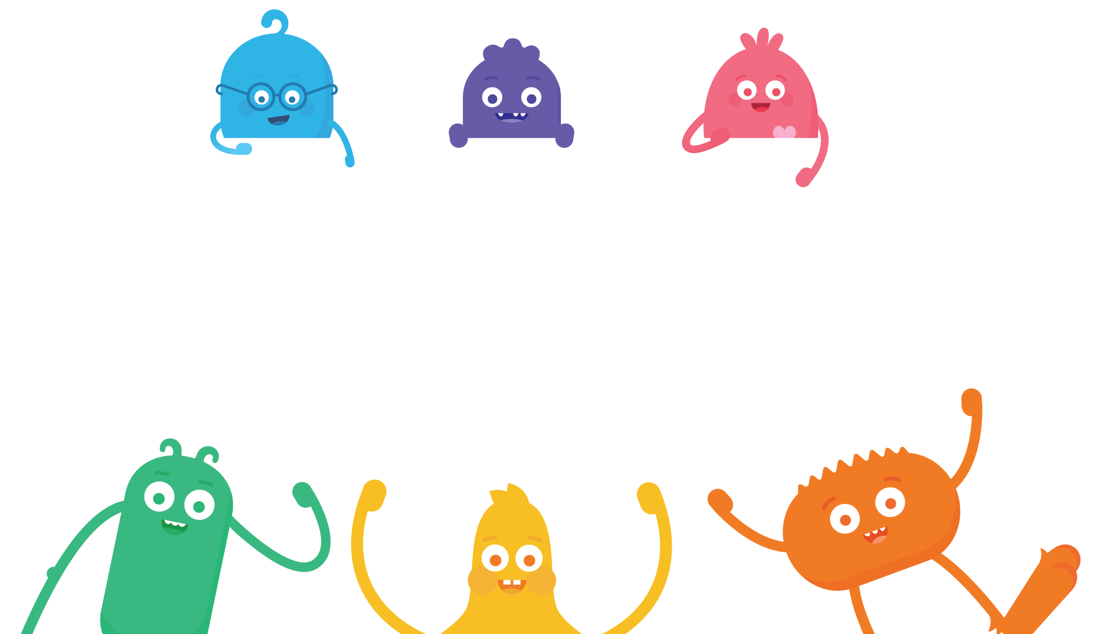

How can we be safe, responsible, and respectful online?

Slide 3

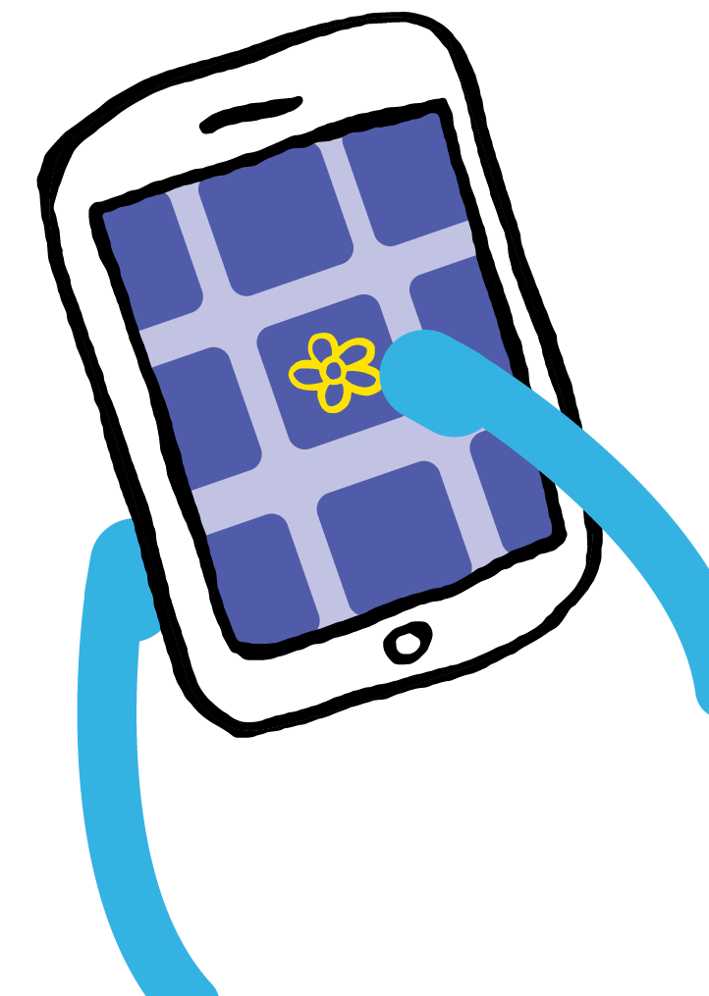

KEY VOCABULARY
Online
Using a computer, phone, or tablet to visit a website or app

Slide 4
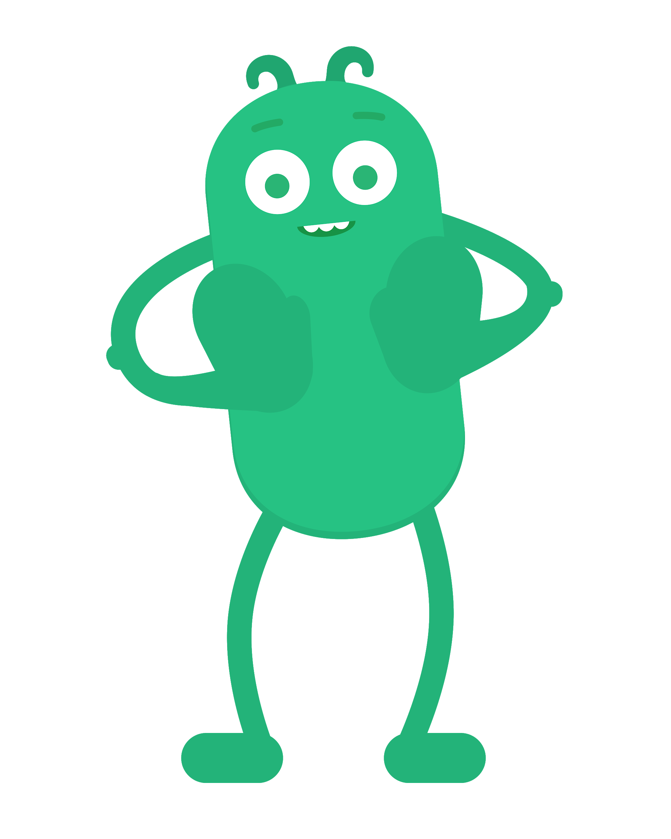
KEY VOCABULARY
Pause
To stop what you're doing or saying

Slide 5
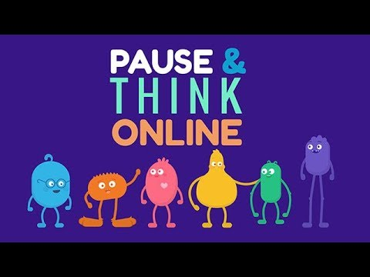
WATCH
To watch this video on the Common Sense Education site, click here.

Slide 6
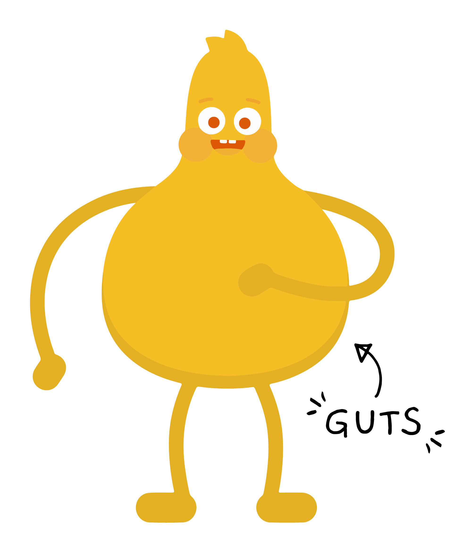

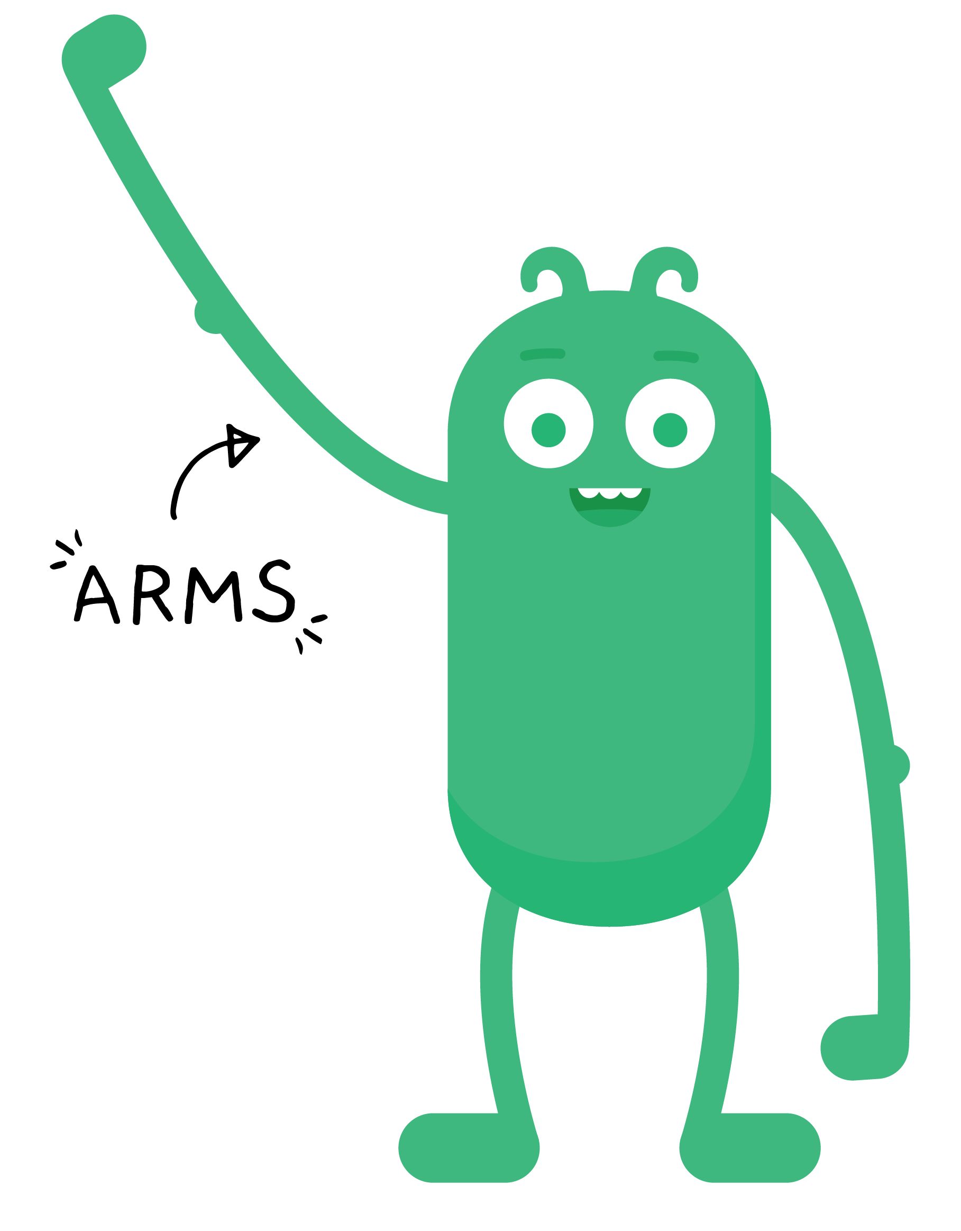
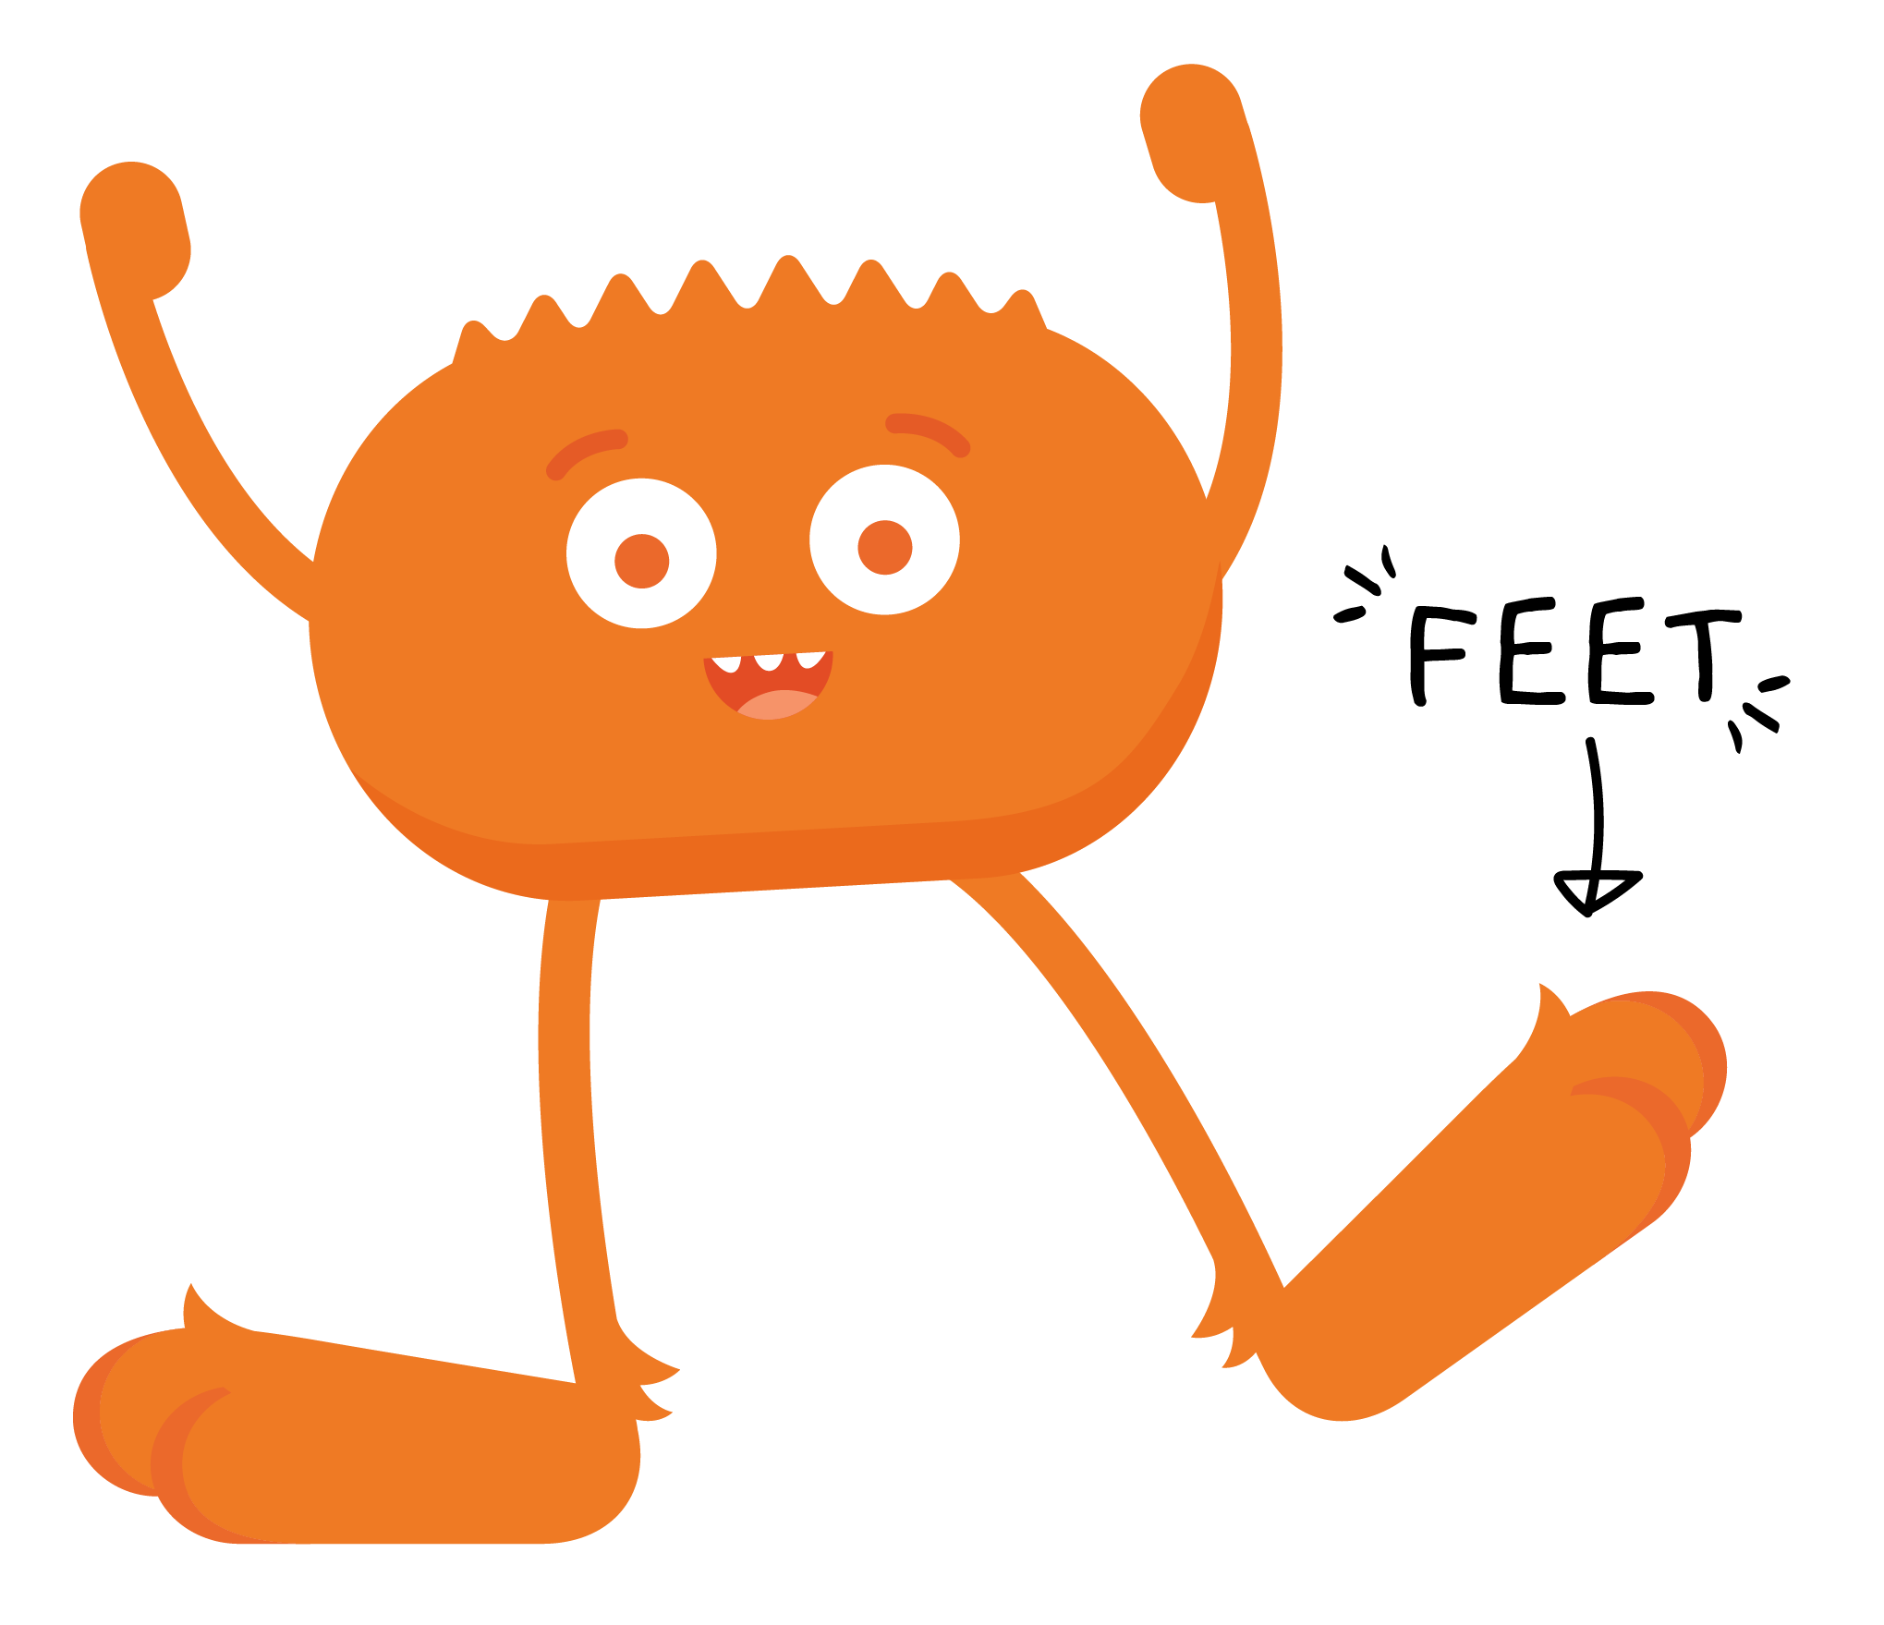
REVIEW

Slide 7

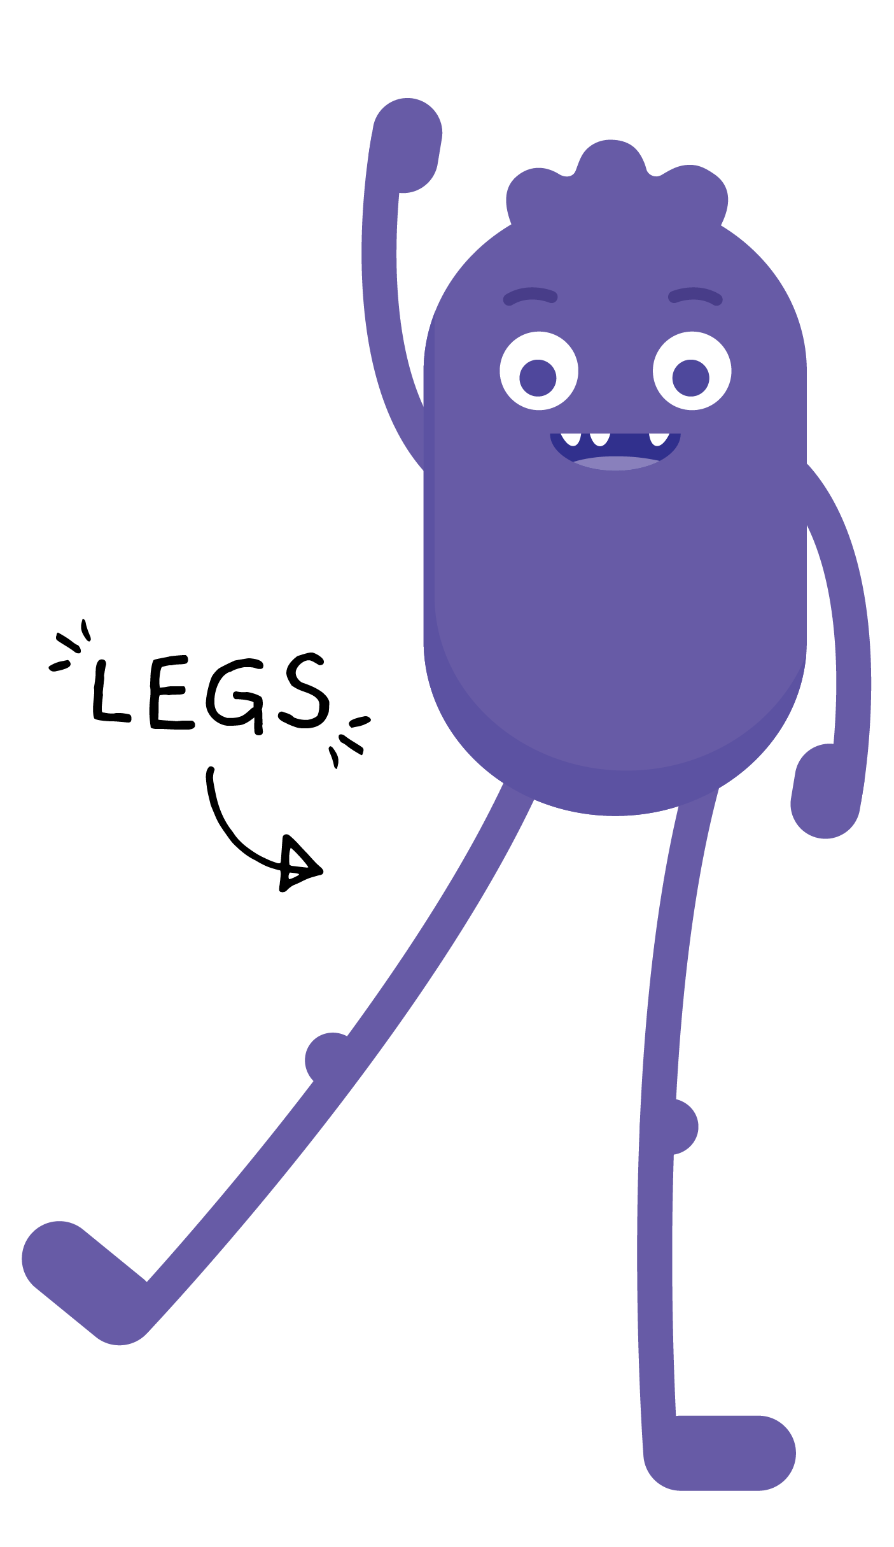
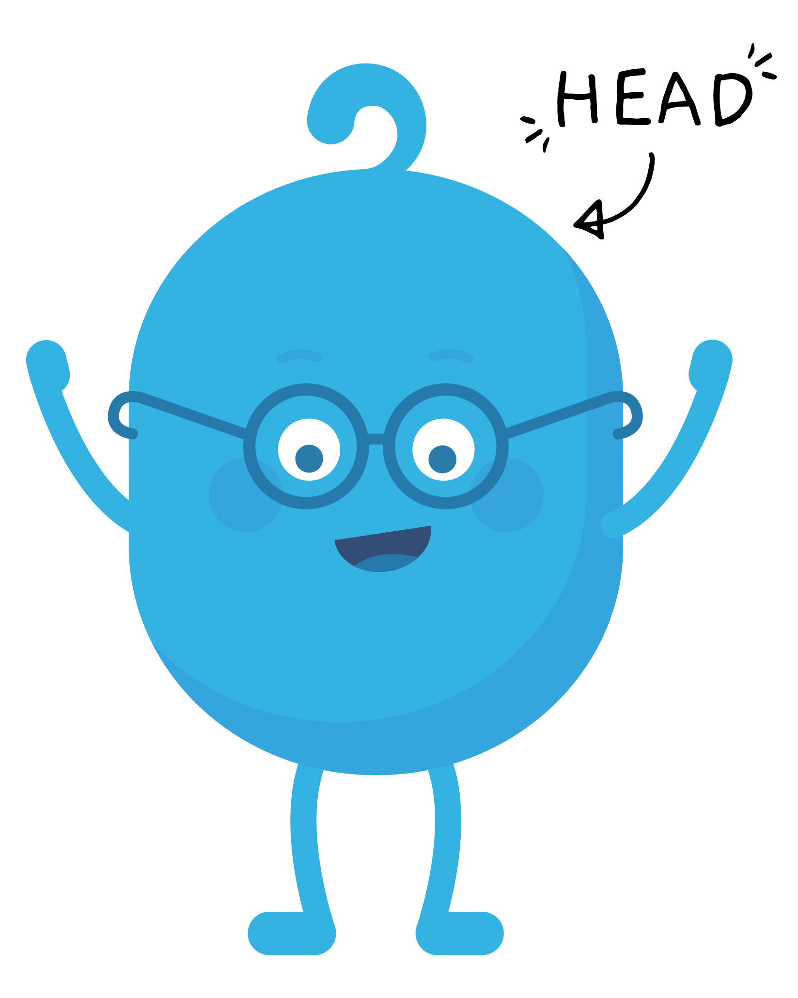
REVIEW

Slide 8



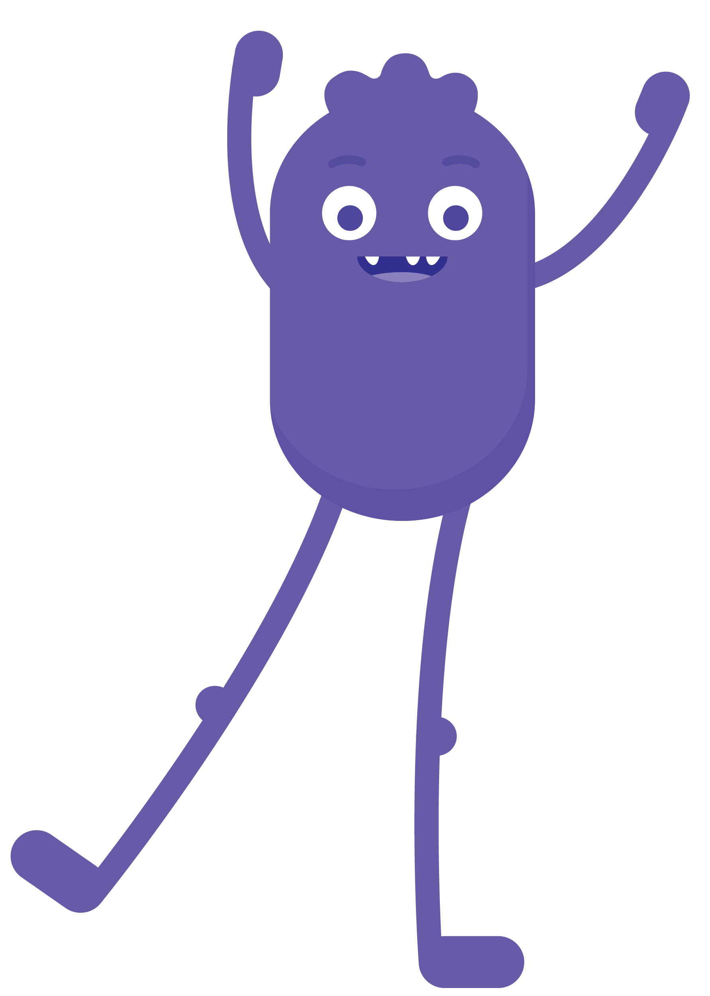


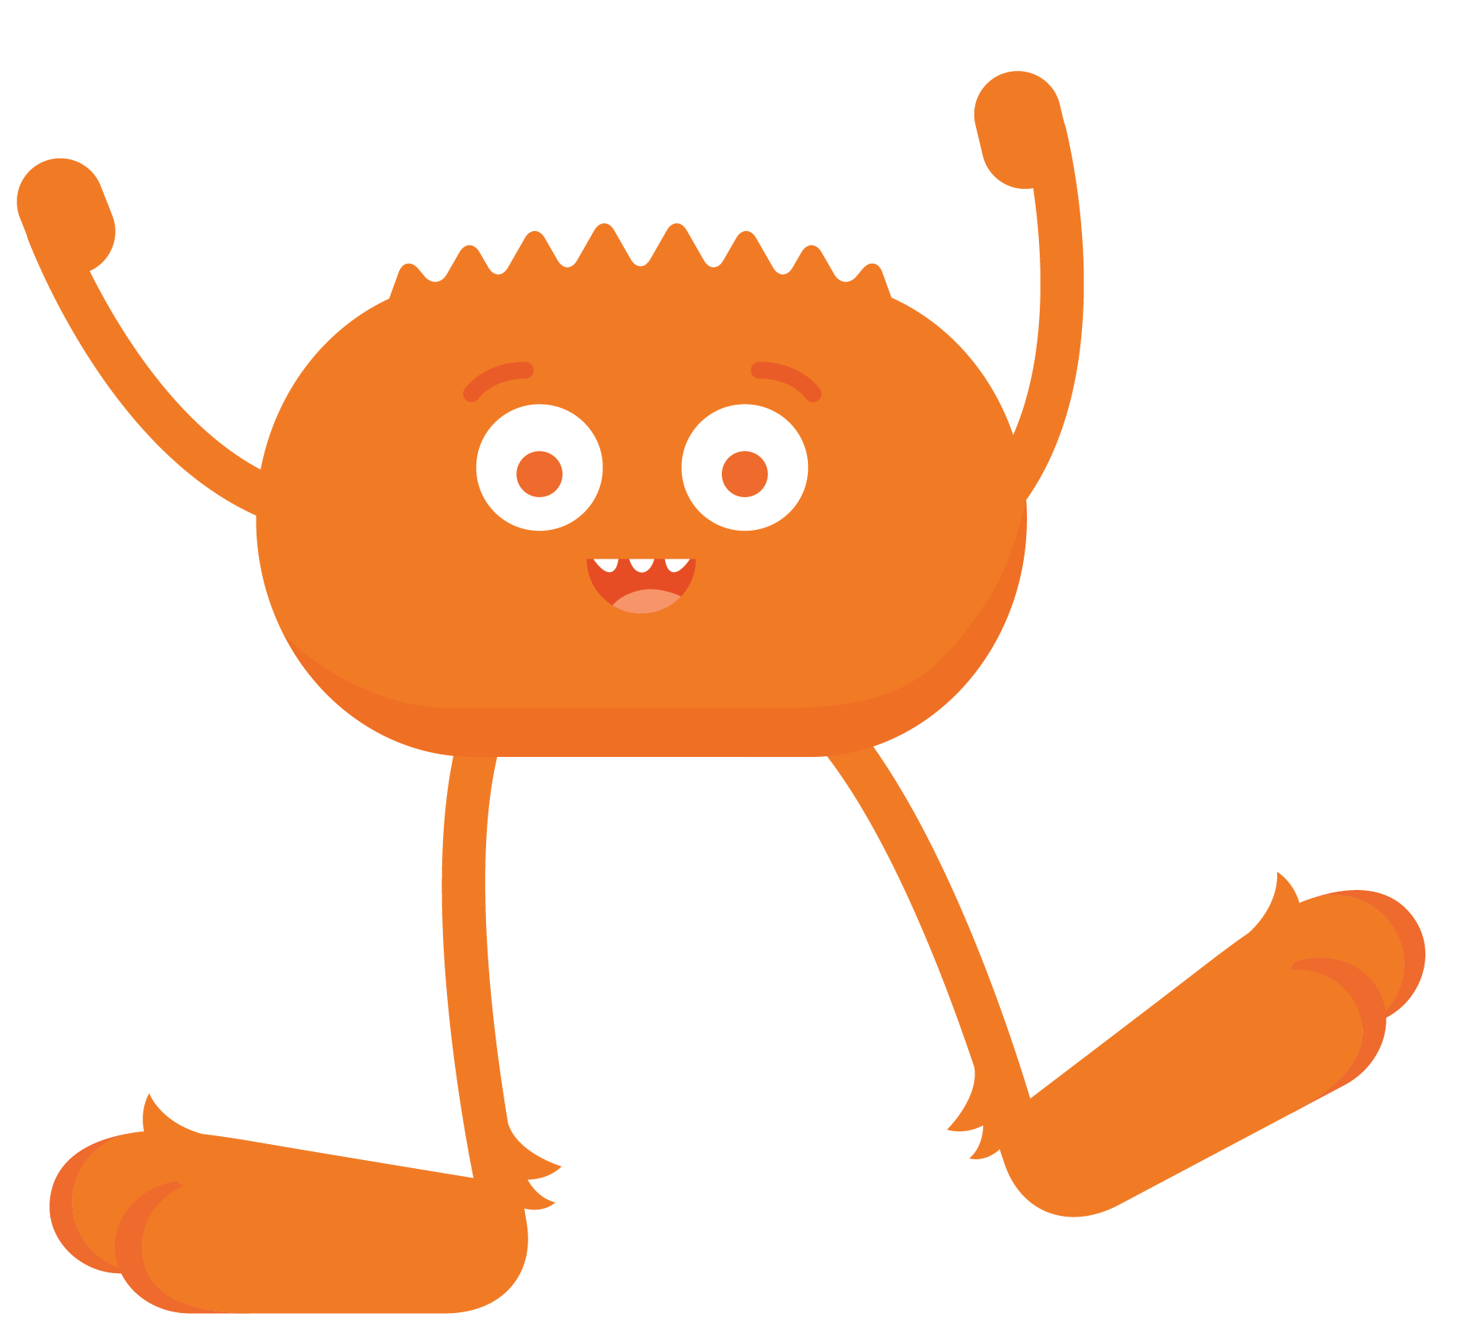
PAIR-SHARE
Which character do you relate to the most when you go online?

Slide 9
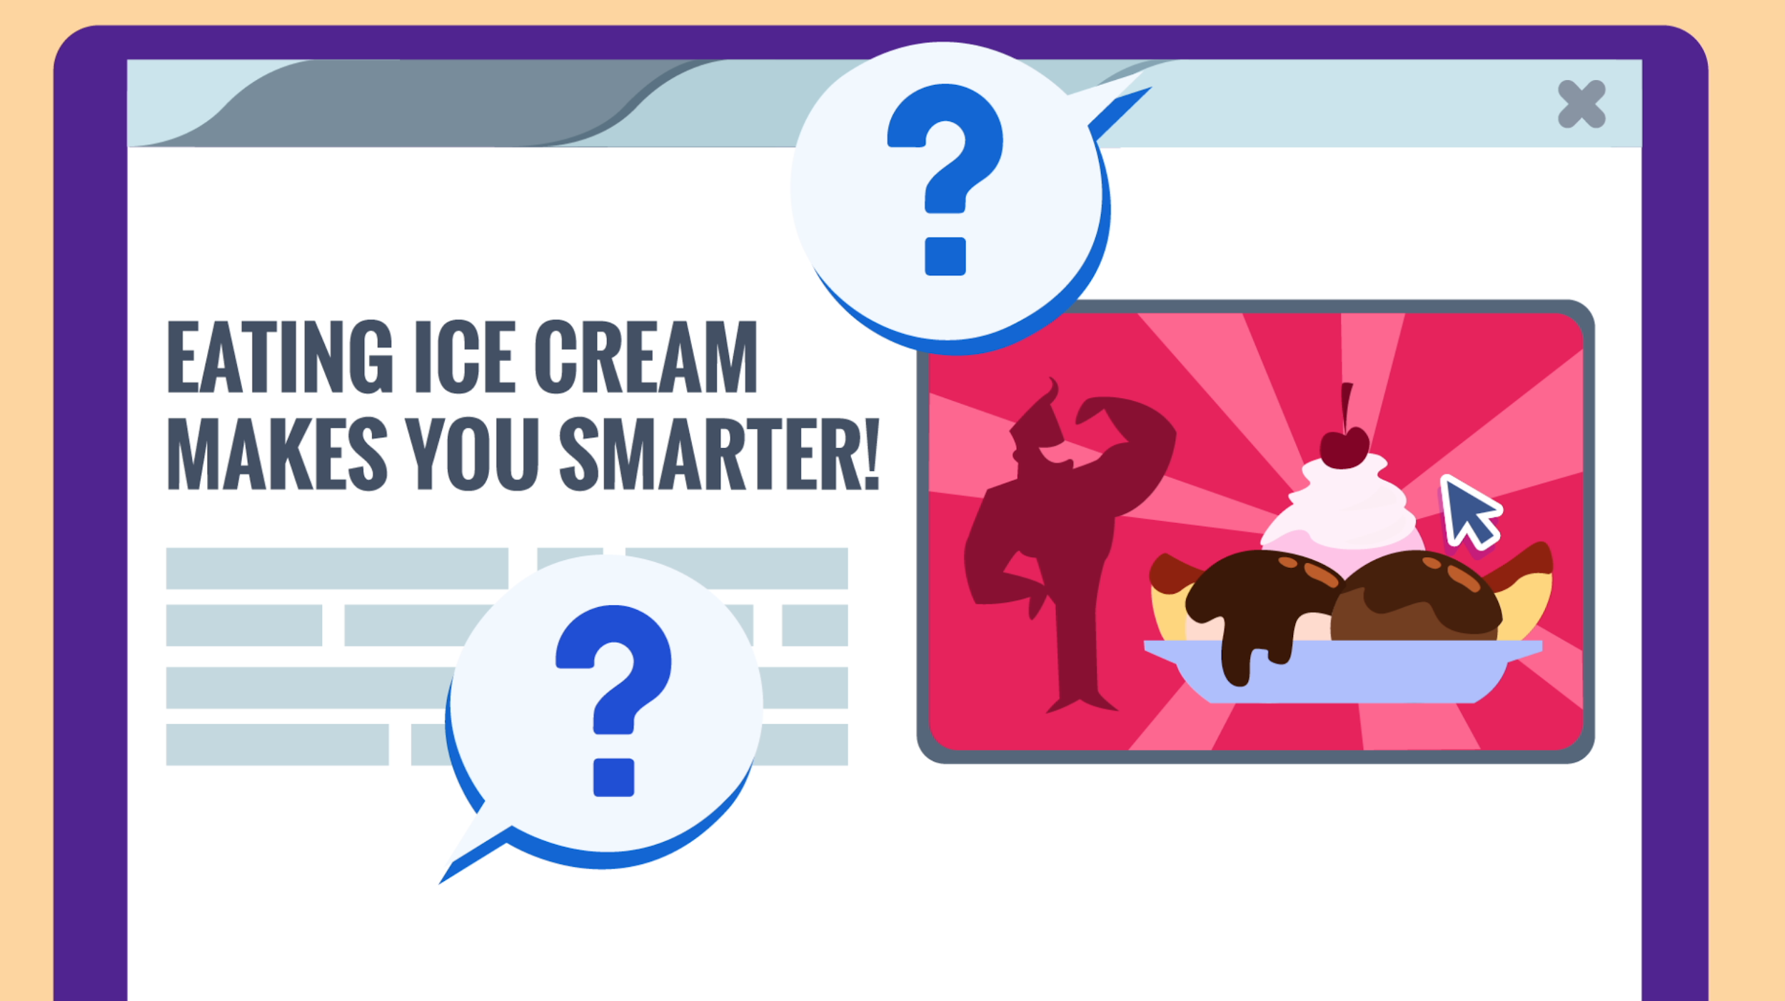
PAIR-SHARE
Do you believe everything you see on the internet?

Slide 10
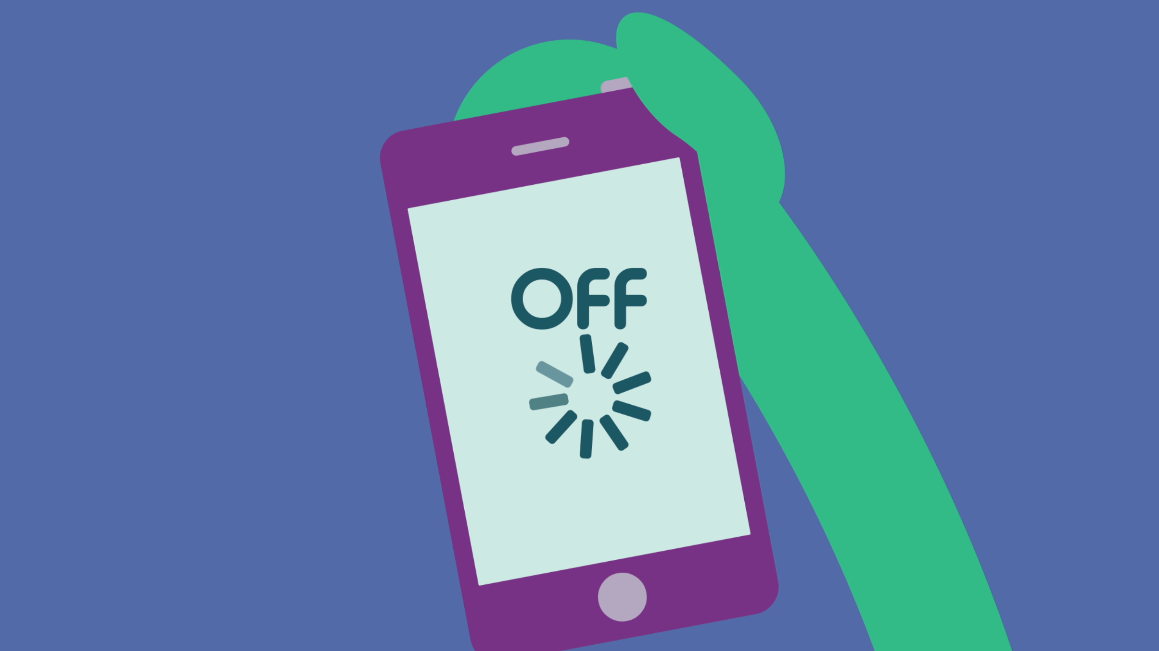
PAIR-SHARE
Why should
we take a break from technology sometimes?

Slide 11
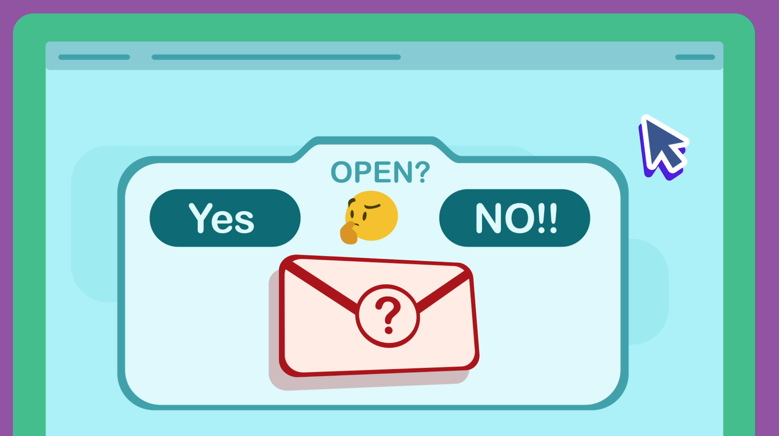
PAIR-SHARE
Why shouldn't you open a message from someone you don’t know?

Slide 12
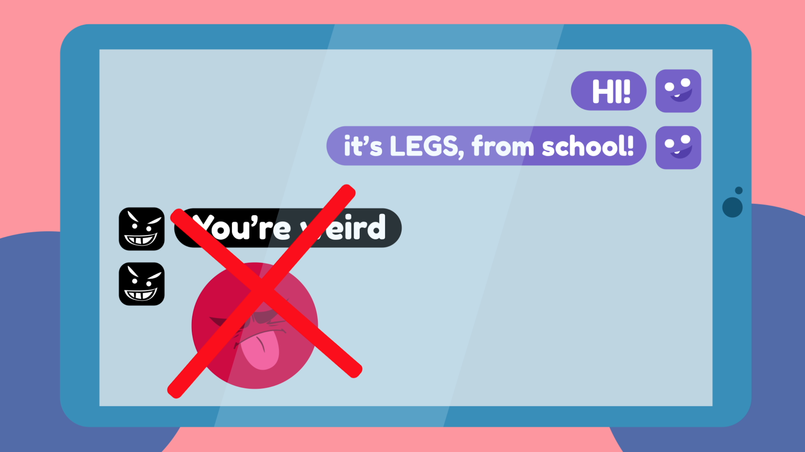
PAIR-SHARE
Why is it important
to be kind online?

Slide 13
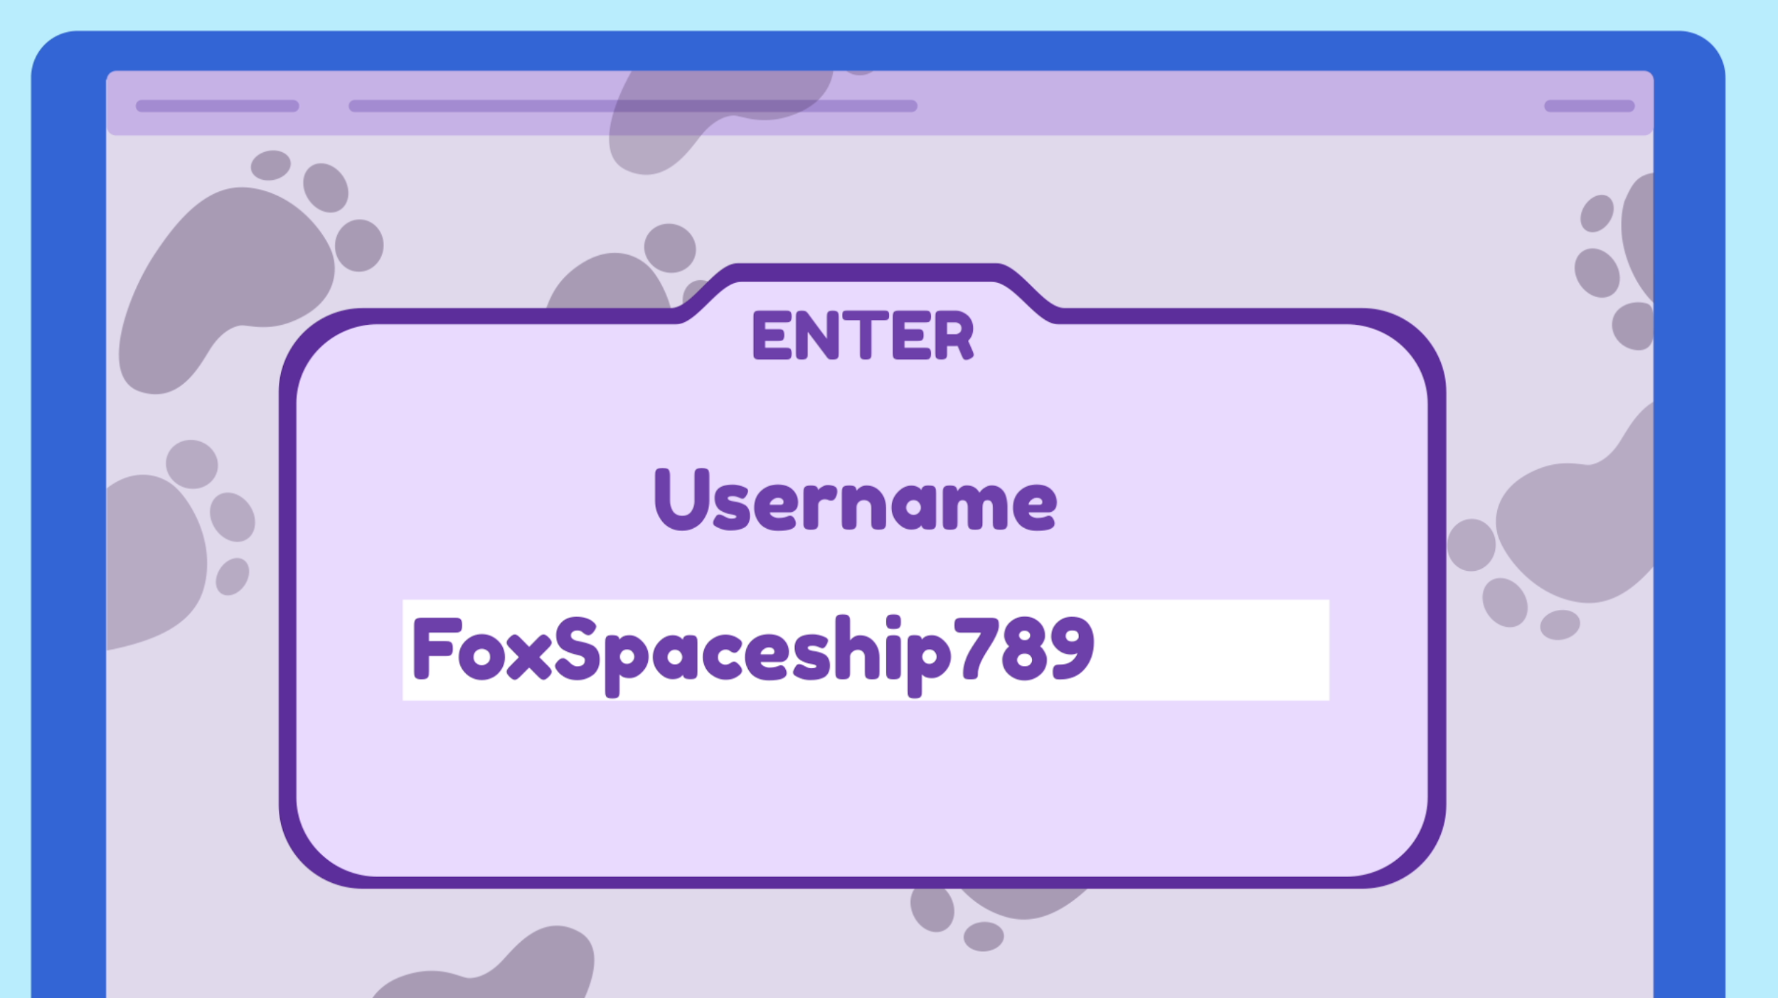
PAIR-SHARE
Why shouldn't you share your username and password with other people?

Slide 14
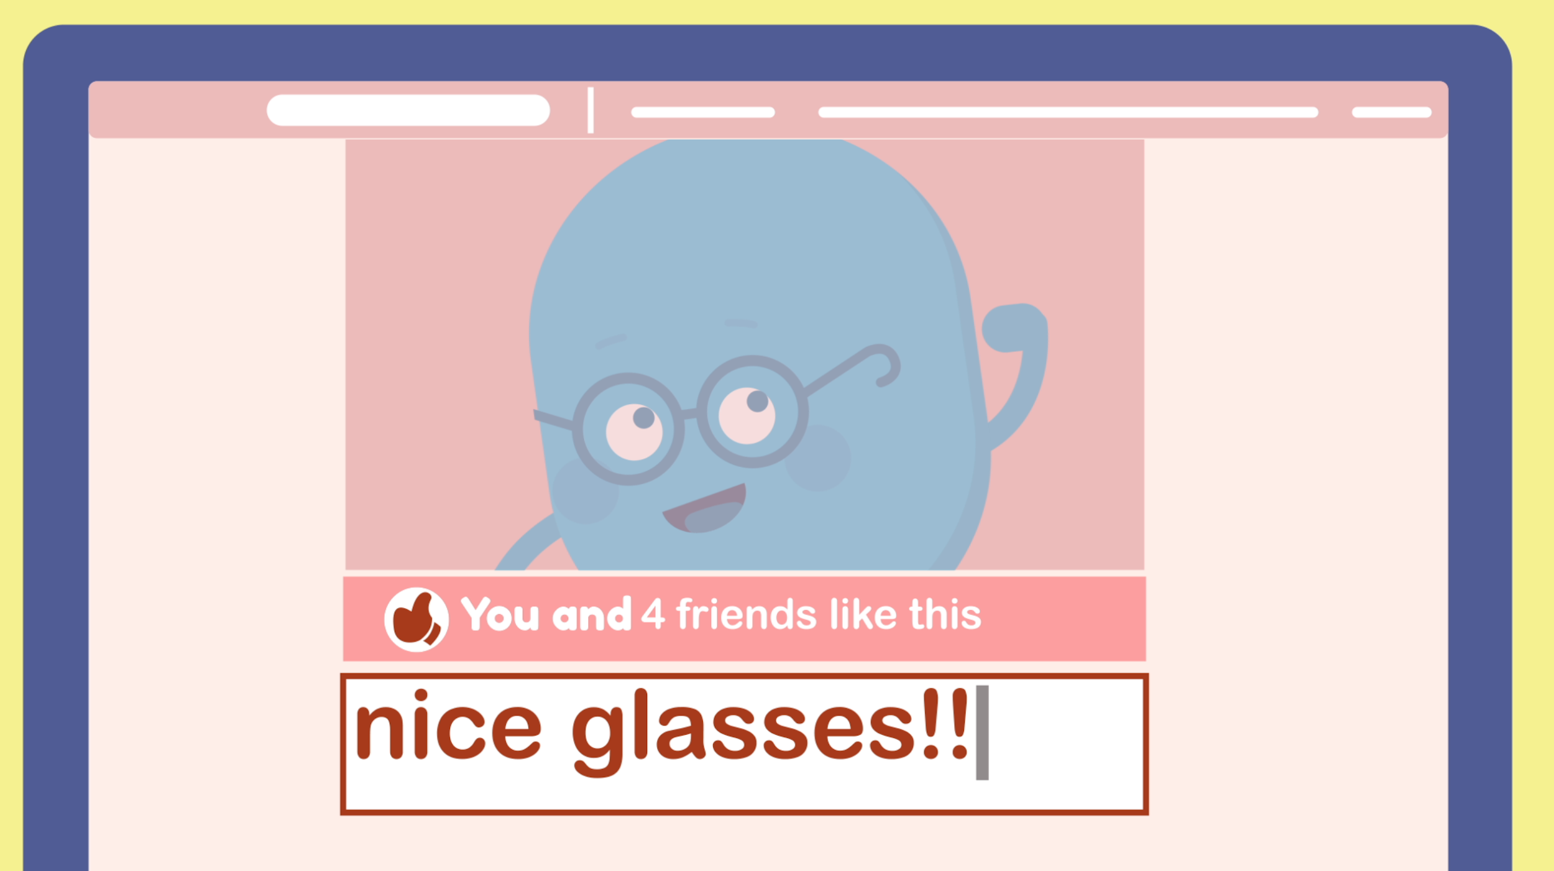
PAIR-SHARE
How do you communicate with friends and family online?

Slide 15

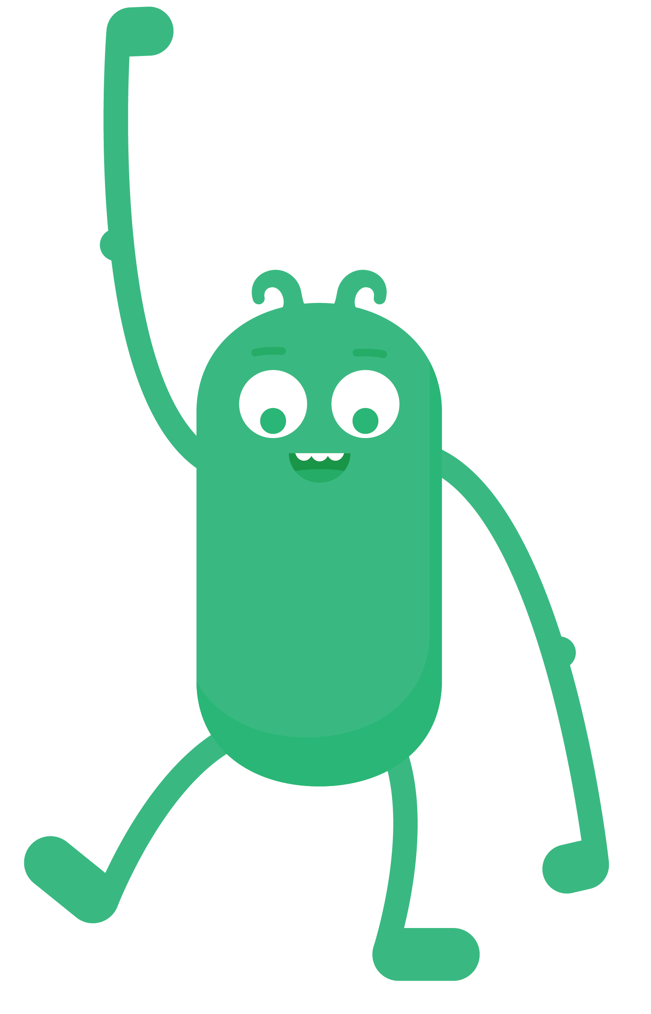

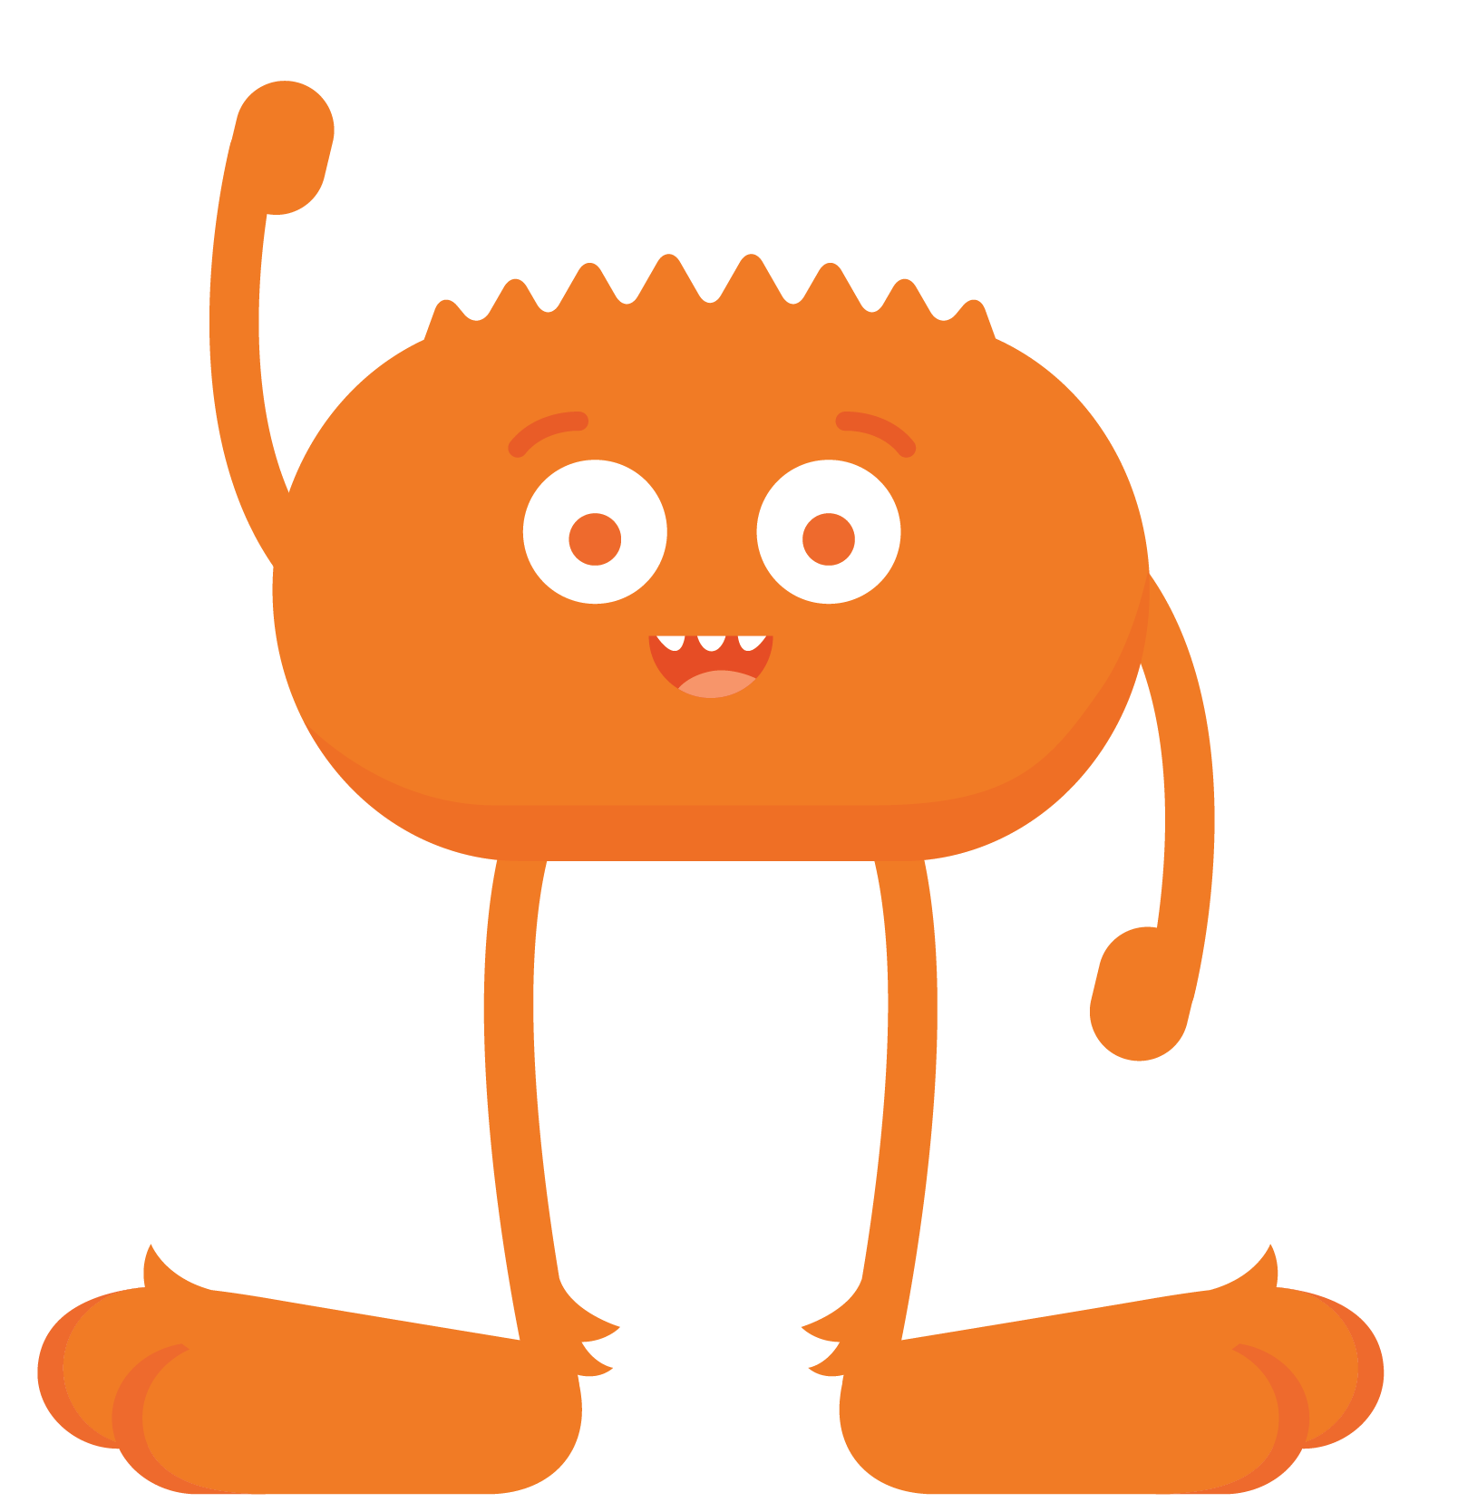
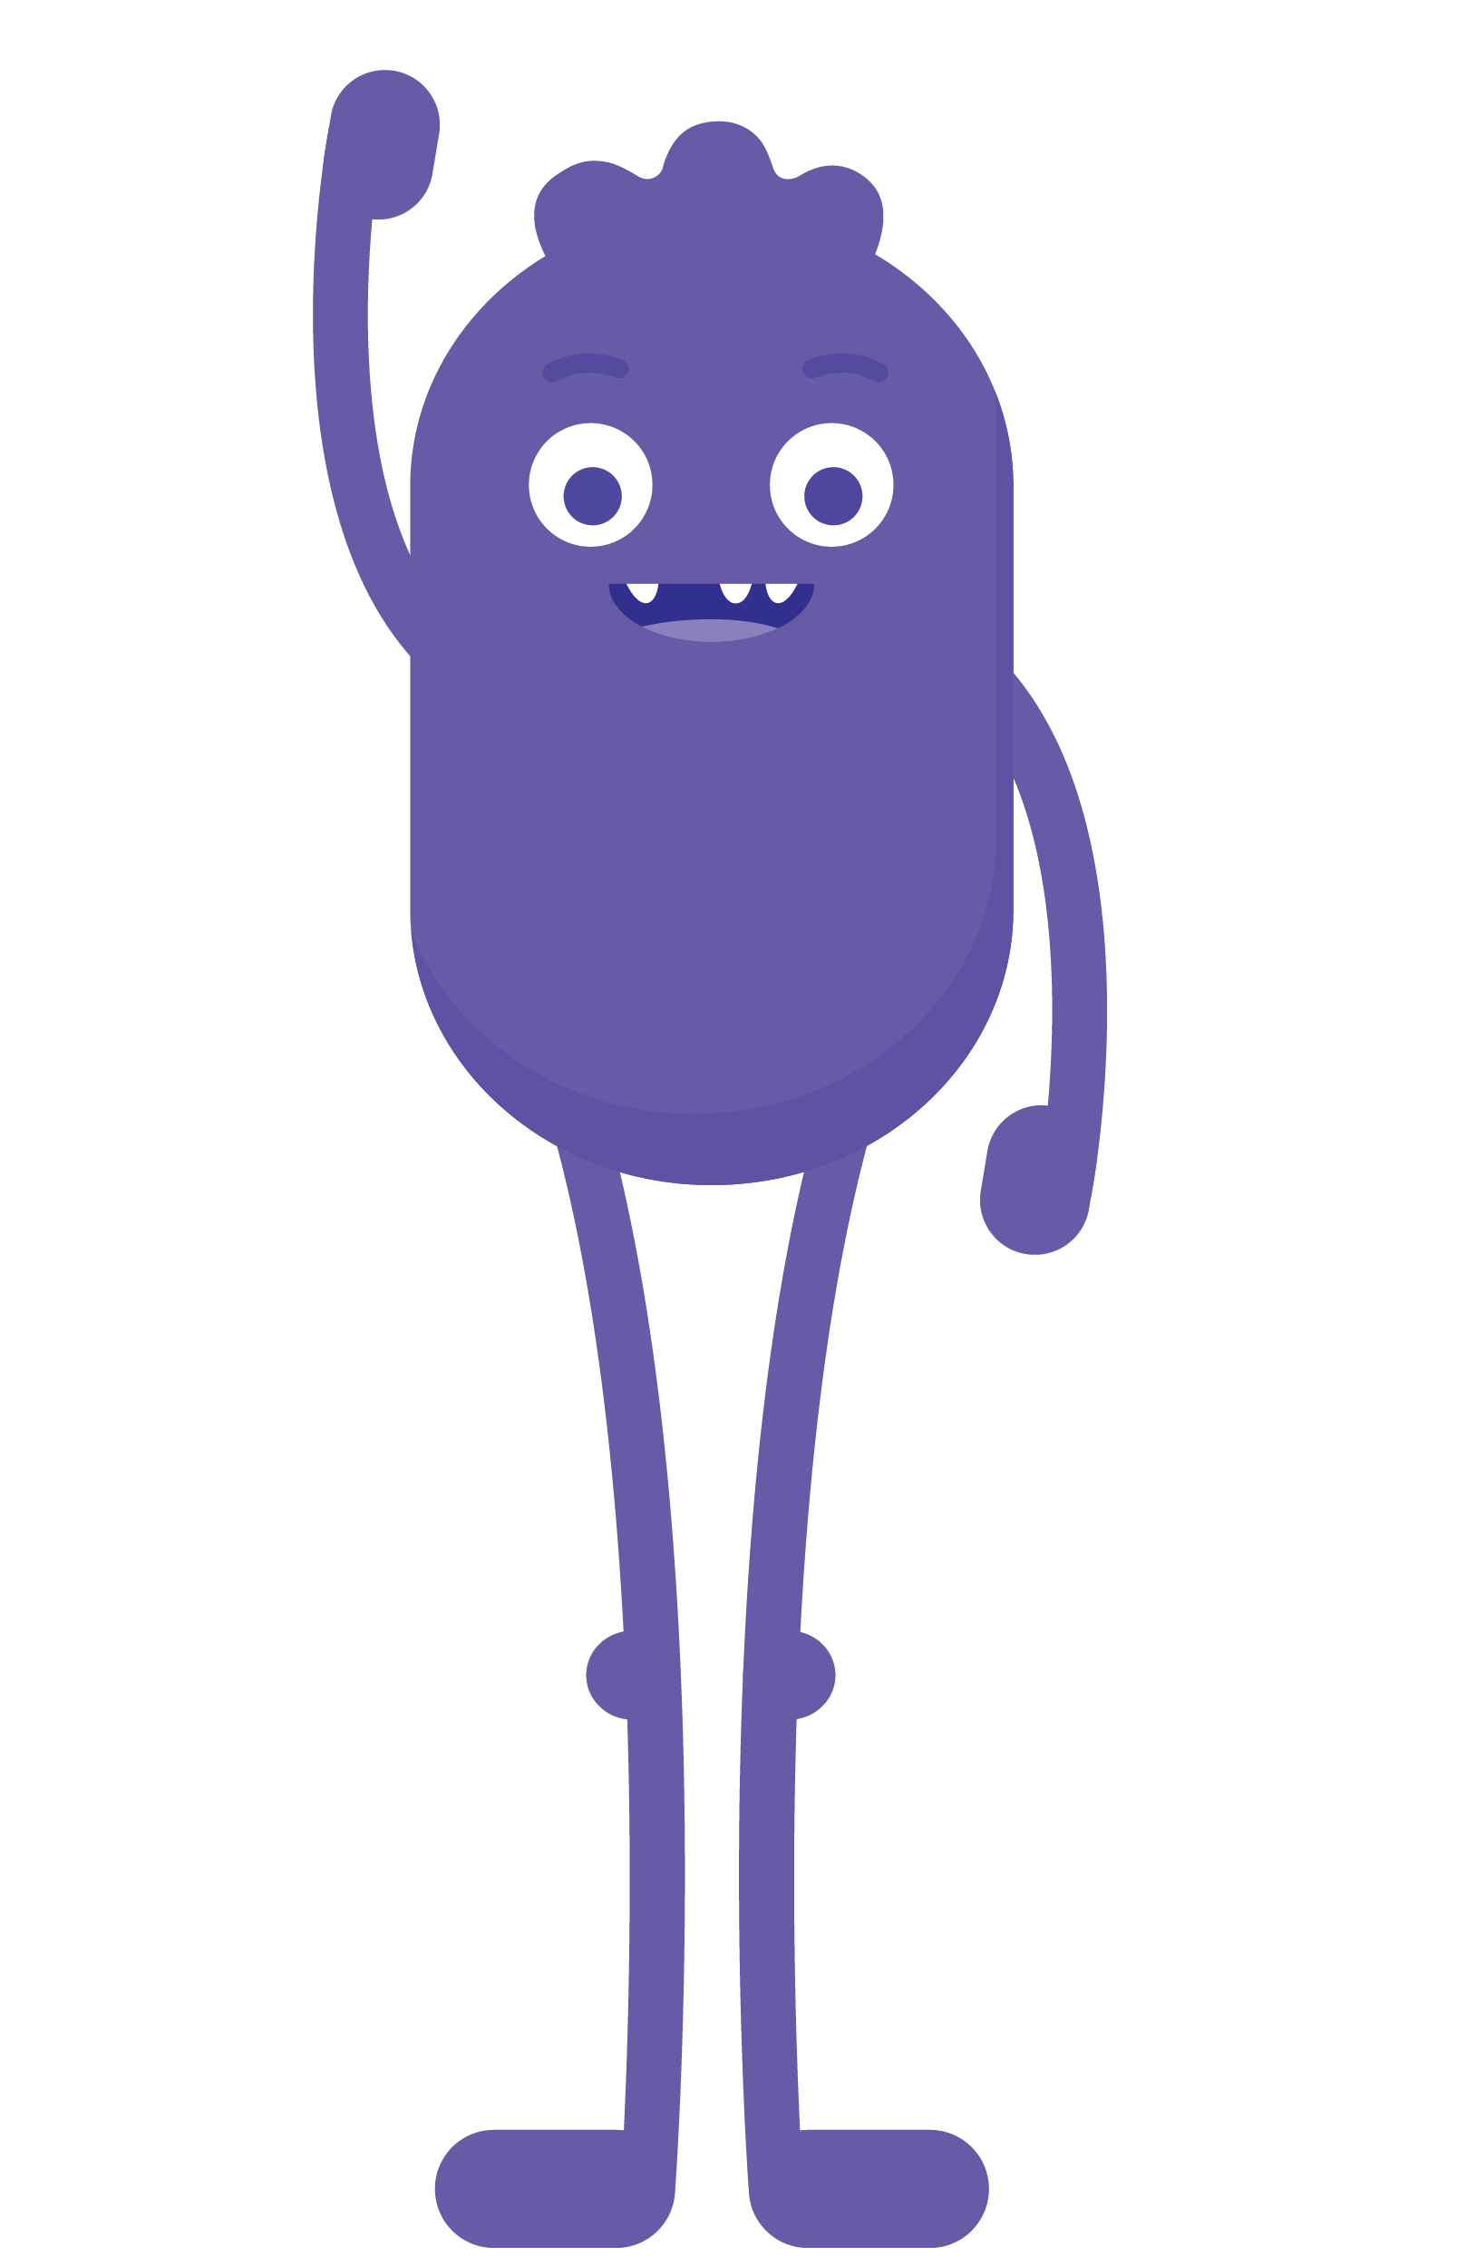



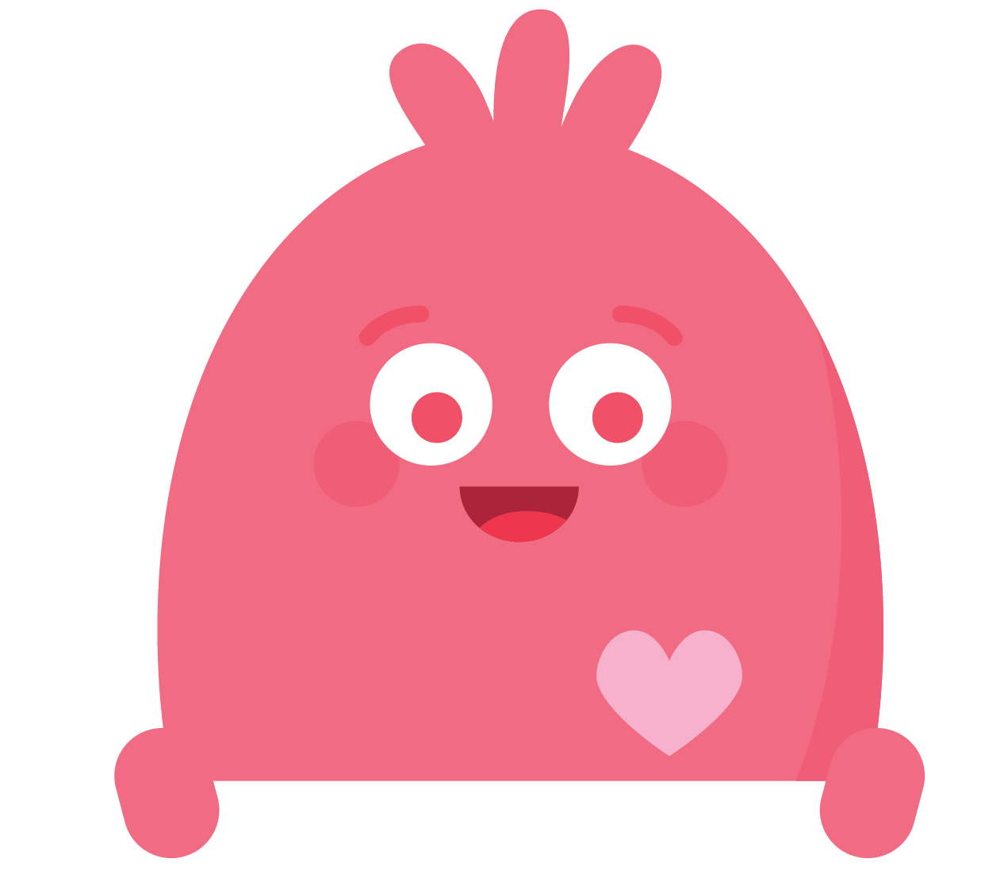
REFLECT HANDOUT
Pause & Think Moment
Draw a picture to show how you will be like one of the Digital Citizens next time you're online.
Write about how you will be like one of the Digital Citizens next time you're online.
and

